Slide 1

Wind Turbines in the U.S. & Market Leadership
A Data Driven Analysis of the US Wind Energy Fleet (1982 to 2021)

Slide 2
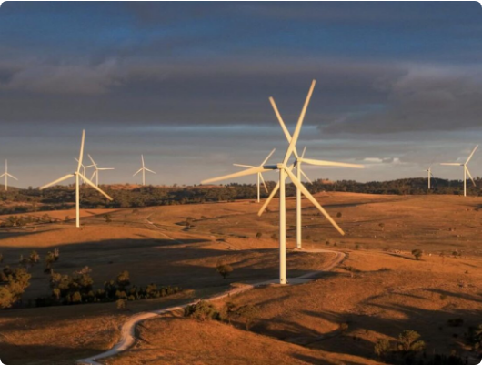
Evolution of Wind Power
Wind energy is one of the fastest growing sources of electricity in the United States. Over the past four decades wind turbines have been completely transformed.
This project explores how small experimental machines became massive utility scale structures powering entire cities.
65,322 turbines analyzed
45 US states represented
Data span from 1982 to 2021

Slide 3
The Core Question
Which wind turbine manufacturer leads U.S. market installations, and does volume reflect performance?

Slide 4









Research Methodology
Physical Growth
Efficiency
Manufacturers
Tracking capacity hub height and rotor diameter shifts
Measuring kW output per square meter of rotor area
Top 5 brands ranked by output
Geography
Annual Production
Identifying which manufacturers dominate specific regions
Projected energy production per turbine by brand

Slide 5
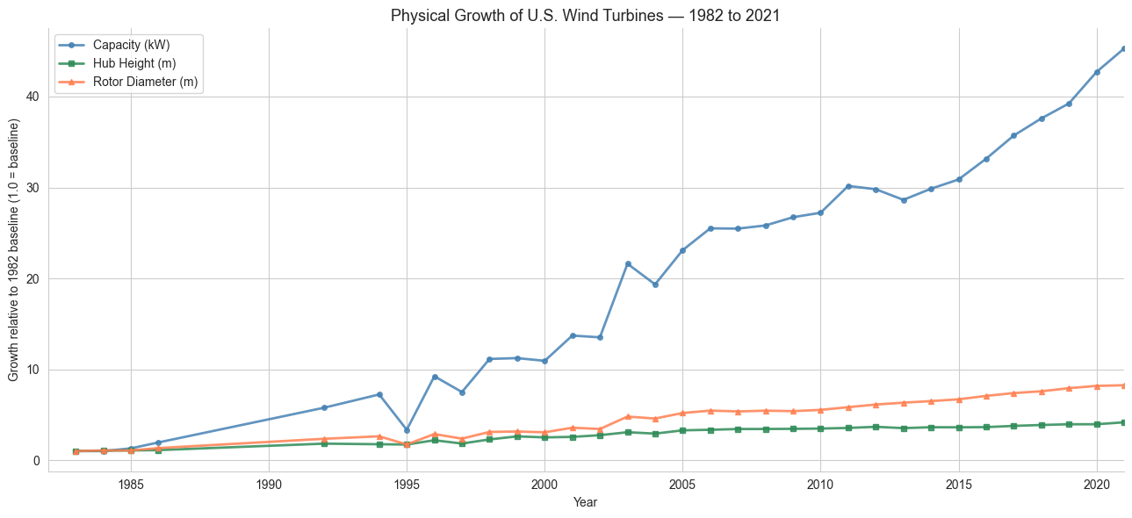
Growth Over the decades
Average capacity grew from 81 kW in 1982 to 2,943 kW in 2021 while hub heights reached 95 meters.

Slide 6
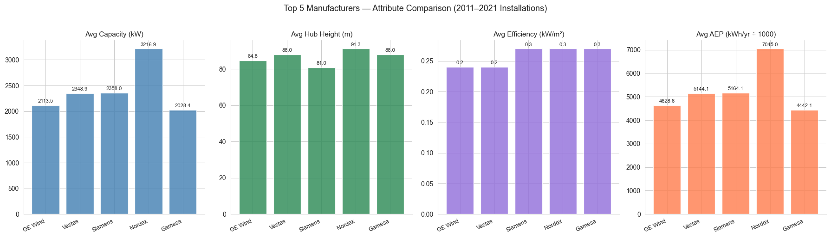
Manufacturer Comparison

Slide 7
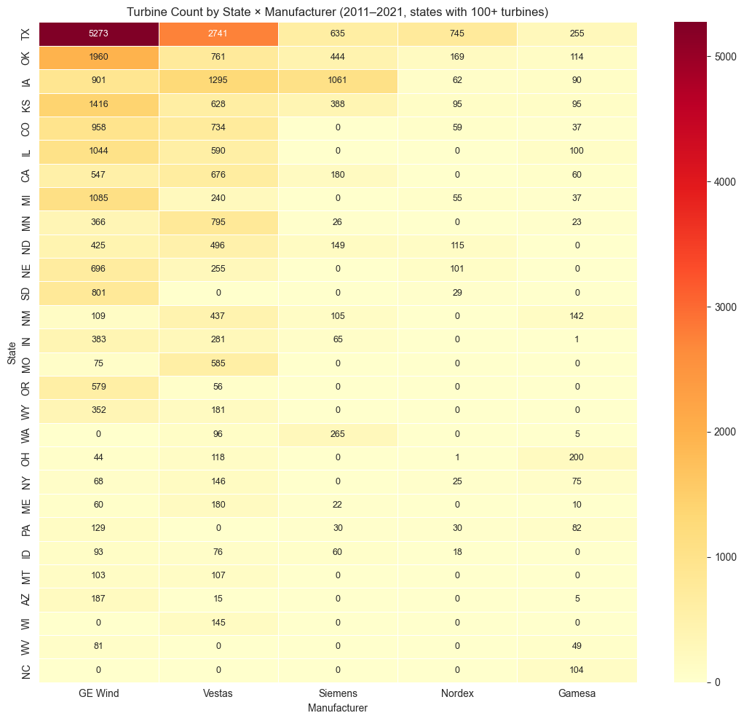
Regional Dominance

Slide 8
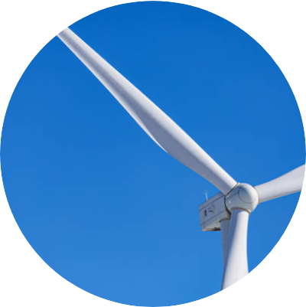
Final Recommendations
Nordex Top Performer
Nordex ranks #1 on capacity height and energy yield. Expected to produce 52% more energy than GE Wind units.
Vestas Balanced Option
Vestas offers the best consistency with the second largest install base and a robust service network across the US.

Slide 9

Questions?
Data Driven Insights into the Evolution of Wind Energy

